Slide 1
MongoDB
Sandra Fernando

Slide 2
Agenda
What is MongoDB
Different between Relational and MongoDB
When to use MongoDB
Features of MongoDB
Where to Download
CURD
No Joins
Arrays
Aggregation Pipelines
Tools

Slide 3
To get started, there are six simple concepts we need to understand.
MongoDB has the same concept of a database with which you are likely already familiar (or a schema for you Oracle folks). Within a MongoDB instance you can have zero or more databases, each acting as high-level containers for everything else.
A database can have zero or more collections. A collection shares enough in common with a traditional table that you can safely think of the two as the same thing.
Collections are made up of zero or more documents. Again, a document can safely be thought of as a row.
A document is made up of one or more fields, which you can probably guess are a lot like columns. Indexes in MongoDB function mostly like their RDBMS counterparts.
Cursors are different than the other five concepts but they are important enough, and often overlooked, that I think they are worthy of their own discussion. The important thing to understand about cursors is that when you ask MongoDB for data, it returns a pointer to the result set called a cursor, which we can do things to, such as counting or skipping ahead, before actually pulling down data.

Slide 4
MongoDB
To recap, MongoDB is made up of databases which contain collections. A collection is made up of documents. Each document is made up of fields. Collections can be indexed, which improves lookup and sorting performance.
Why use new terminology (collection vs. table, document vs. row and field vs. column)? Is it just to make things more complicated?
The truth is that while these concepts are similar to their relational database counterparts, they are not identical. The core difference comes from the fact that relational databases define columns at the table level whereas a document-oriented database defines its fields at the document level.
That is to say that each document within a collection can have its own unique set of fields. As such, a collection is a dumbed down container in comparison to a table, while a document has a lot more information than a row.

Slide 5
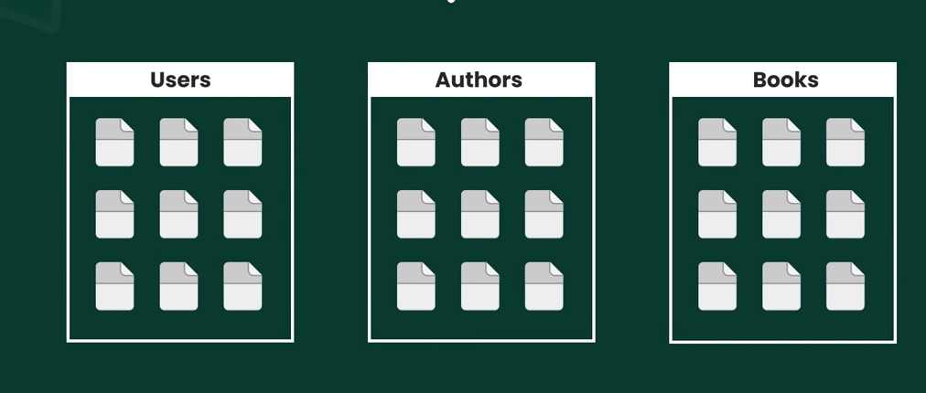
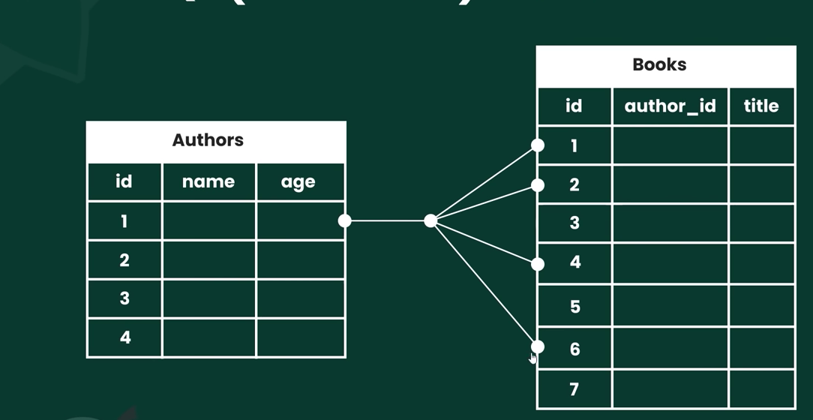
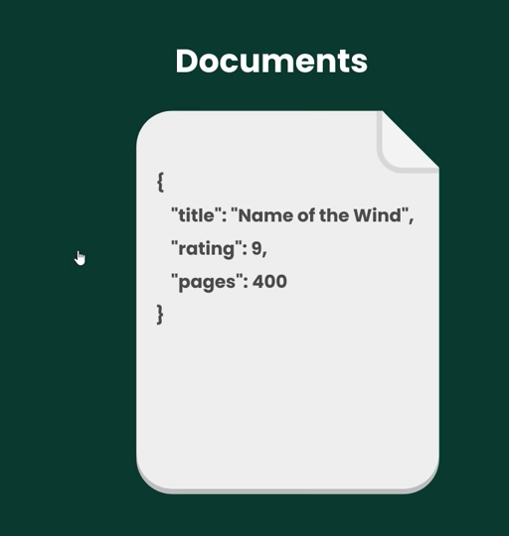
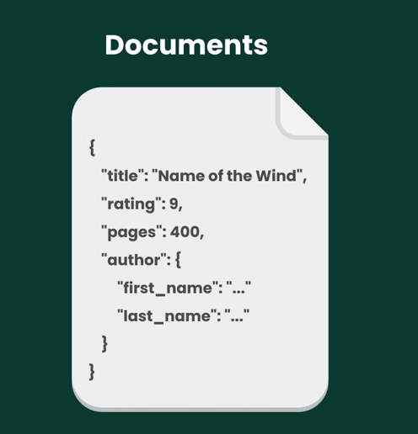
Relational Vs MongoDB

Slide 6
When To Use MongoDB
The most important lesson, which has nothing to do with MongoDB, is that you no longer have to rely on a single solution for dealing with your data. No doubt, a single solution has obvious advantages, and for a lot projects - possibly even most - a single solution is the sensible approach.
The idea isn’t that you must use different technologies, but rather that you can. Only you know whether the benefits of introducing a new solution outweigh the costs.
Notice, MongoDB is not a replacement for relational databases, but rather an alternative. It’s a tool that can do what a lot of other tools can do. Some of it MongoDB does better, some of it MongoDB does worse.

Slide 7
Features of MongoDB
Flexible Schema
The important benefit of document-oriented database is that they don’t enforce a fixed schema. This makes them much more flexible than traditional database tables. Flexible schema is a nice feature, but not for the main reason most people think.
People talk about schema-less as though you’ll suddenly start storing a crazy mishmash of data. There are domains and data sets which can really be a pain to model using relational databases, but those as edge cases. Schema-less is cool, but most of your data is going to be highly structured.
Writes
One area where MongoDB can fit a specialized role is in logging. There are two aspects of MongoDB which make writes quite fast. First, you have an option to send a write command and have it return immediately without waiting for the write to be acknowledged. Secondly, you can control the write behavior with respect to data durability. These settings, in addition to specifying how many servers should get your data before being considered successful, are configurable. Per-write, giving you a great level of control over write performance and data durability.

Slide 8
Durability
Prior to version 1.8, MongoDB did not have single-server durability. That is, a server crash would likely result in lost or corrupt data. The solution had always been to run MongoDB in a multi-server setup (MongoDB supports replication). Journaling was one of the major features added in 1.8. Since version 2.0 MongoDB enables journaling by default, which
allows fast recovery of the server in case of a crash or abrupt power loss.
Full Text Search
True full text search capability is a recent addition to MongoDB. It supports fifteen languages with stemming and stop words. With MongoDB’s support for arrays and full text search you will only need to look to other solutions if you need a more powerful and full-featured full text search engine.

Slide 9
Transactions
MongoDB doesn’t have transactions. It has two alternatives, one which is great but with limited use, and the other that is cumbersome but flexible. The first is its many atomic update operations. These are great, so long as they actually address your problem. Some of the simpler ones, like $inc and $set. There are also commands like findAndModify which can update or delete a document and return it atomically.
Data Processing
Before version 2.2 MongoDB relied on MapReduce for most data processing jobs. As of 2.2 it has added a powerful feature called aggregation framework or pipelining, so you’ll only need to use MapReduce in rare cases where you need complex functions for aggregations that are not yet supported in the pipeline. For now you can think of them as feature-rich and different ways to group by (which is an understatement). For parallel processing of very large data, you may need to rely on something else, such as Hadoop, Spark. Thankfully, since the two systems really do complement each other, there’s a MongoDB connection for Hadoop.

Slide 10
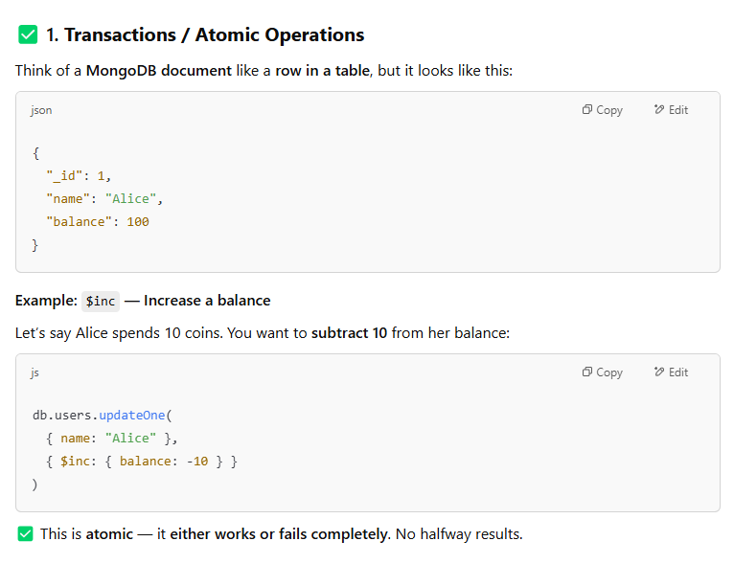

Slide 11
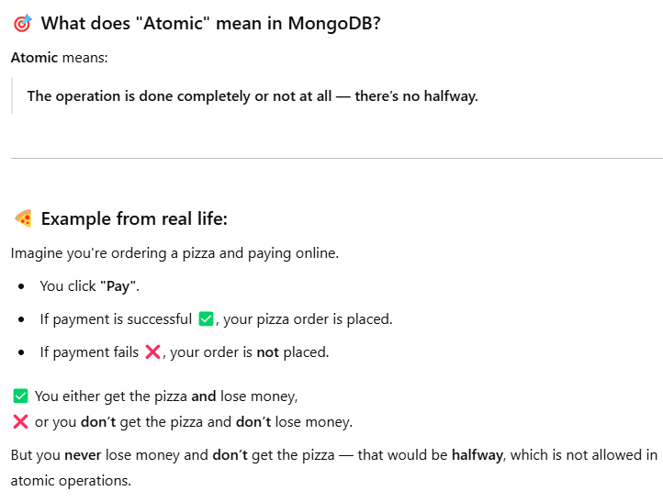
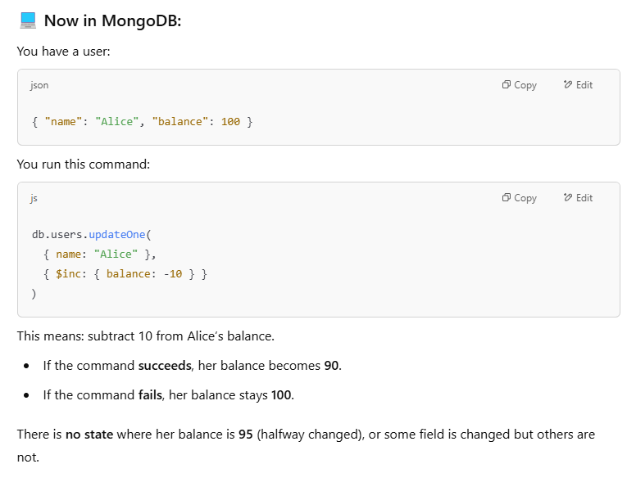
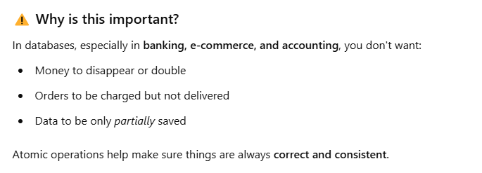

Slide 12
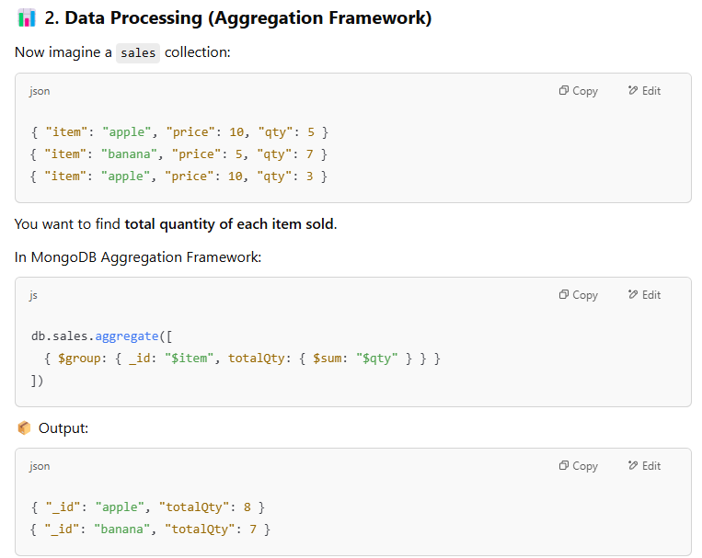
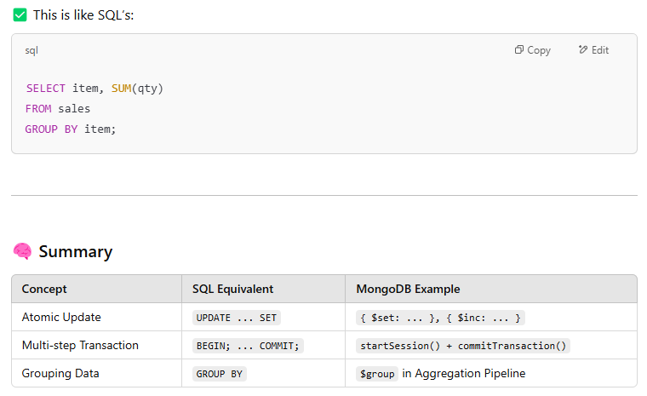

Slide 13
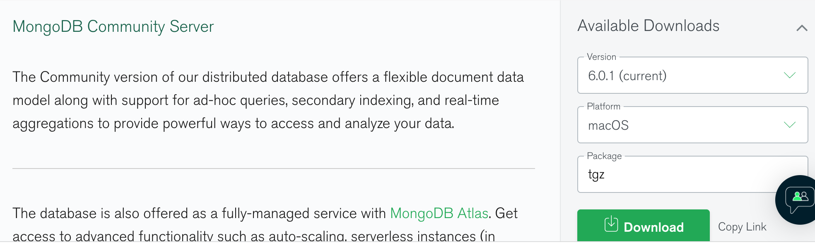
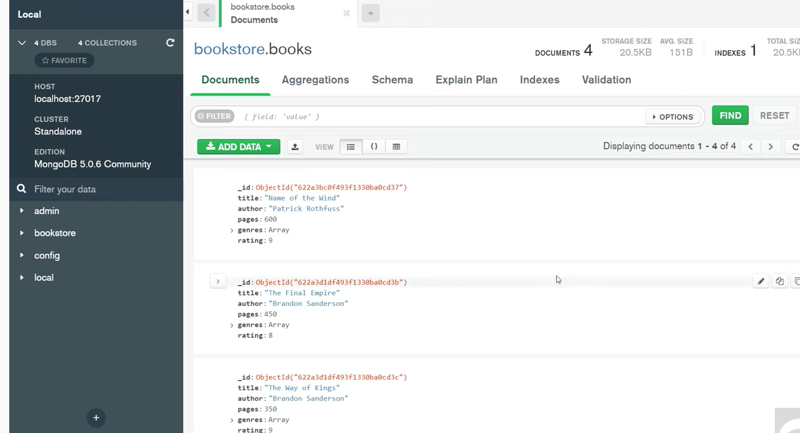
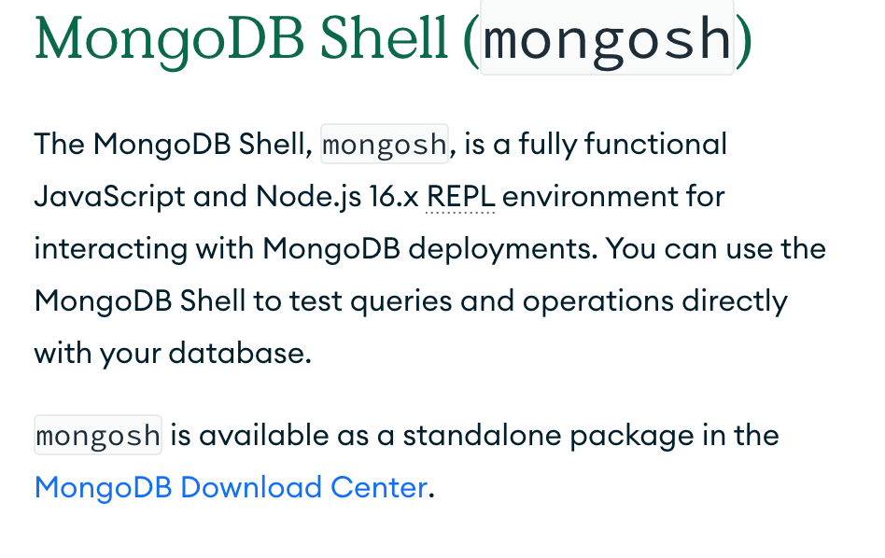
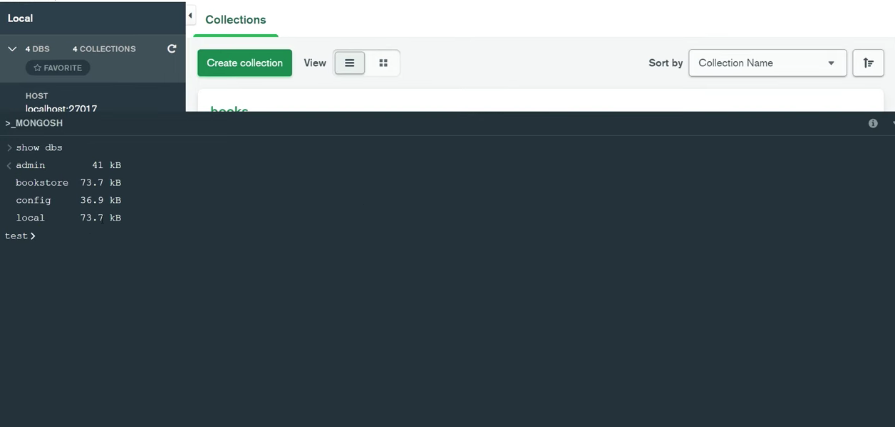
Where to download and how to work with the DB
https://www.mongodb.com/try/download/compass
https://www.mongodb.com/try/download/community
https://www.mongodb.com/docs/mongodb-shell/

Slide 14
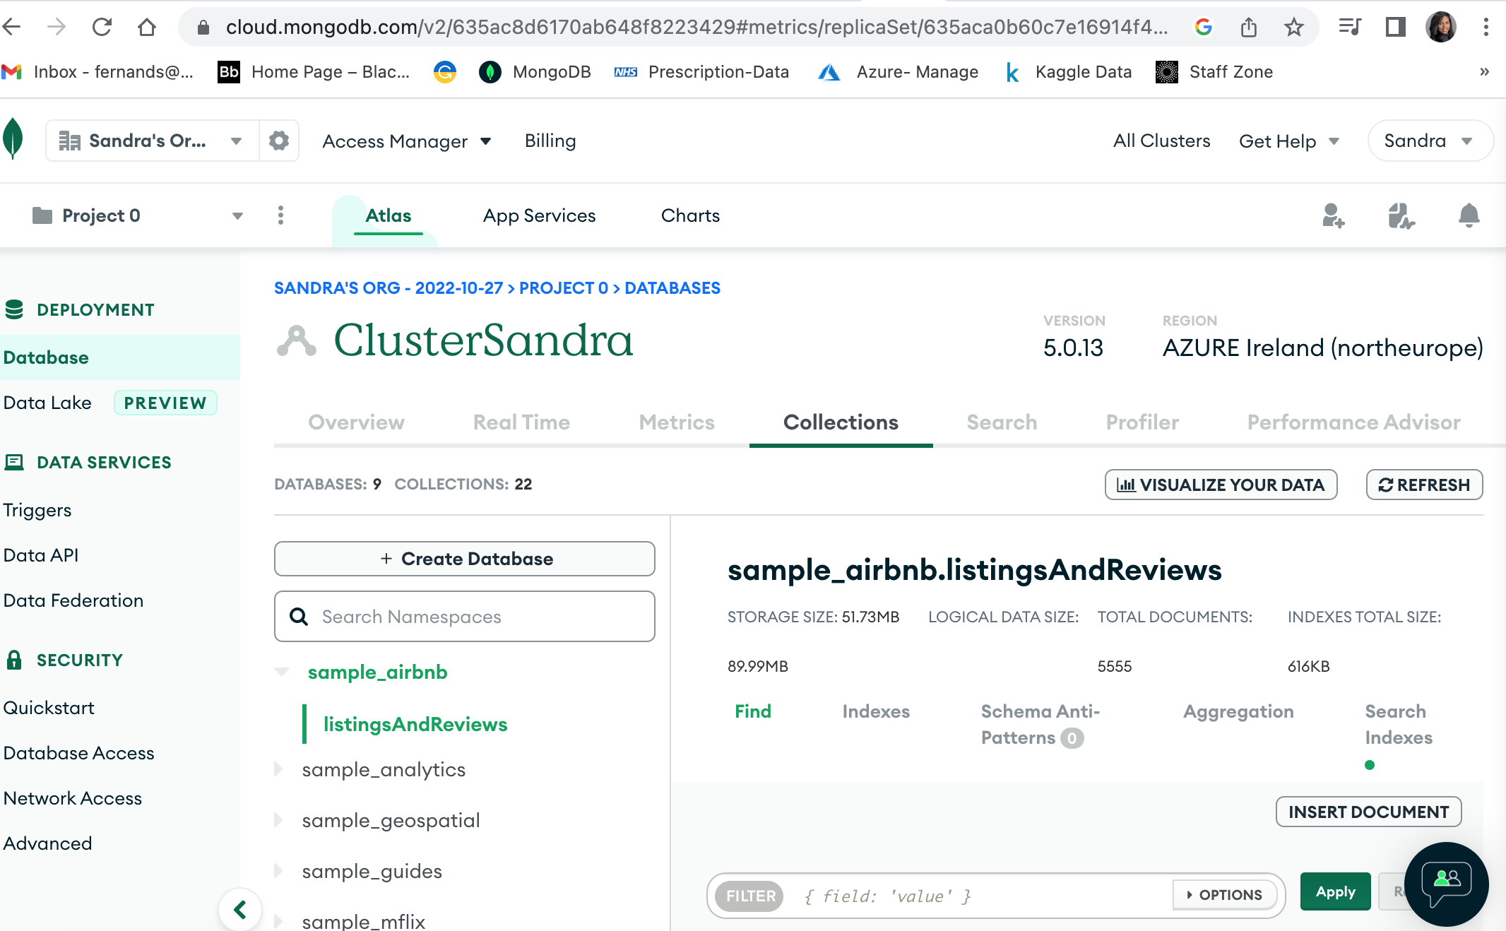
Create an online Altas cluster – cloud MongoDB to access free Sample Databases
Follow steps in https://www.mongodb.com/docs/atlas/tutorial/deploy-free-tier-cluster/
Registration link : https://www.mongodb.com/cloud/atlas/register
See the sample Databases

Slide 15
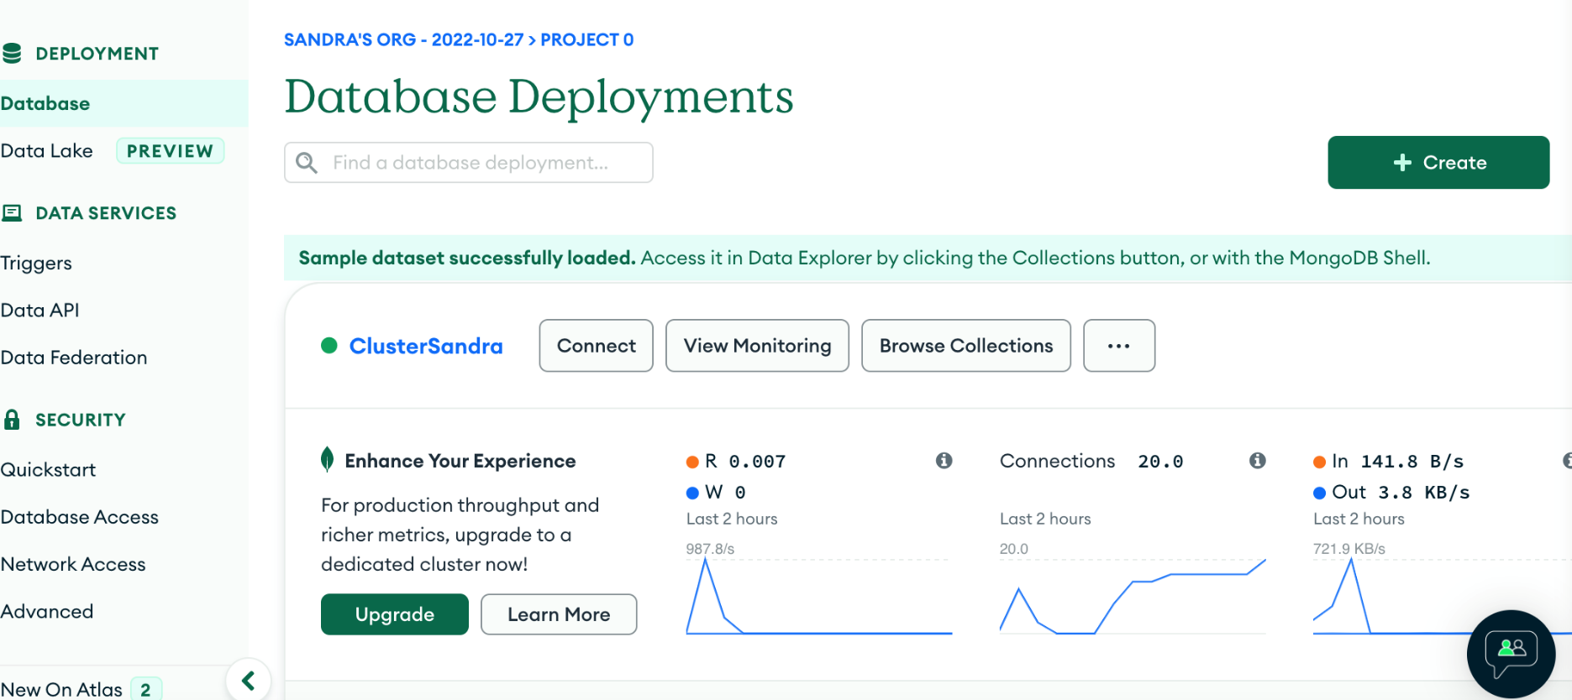
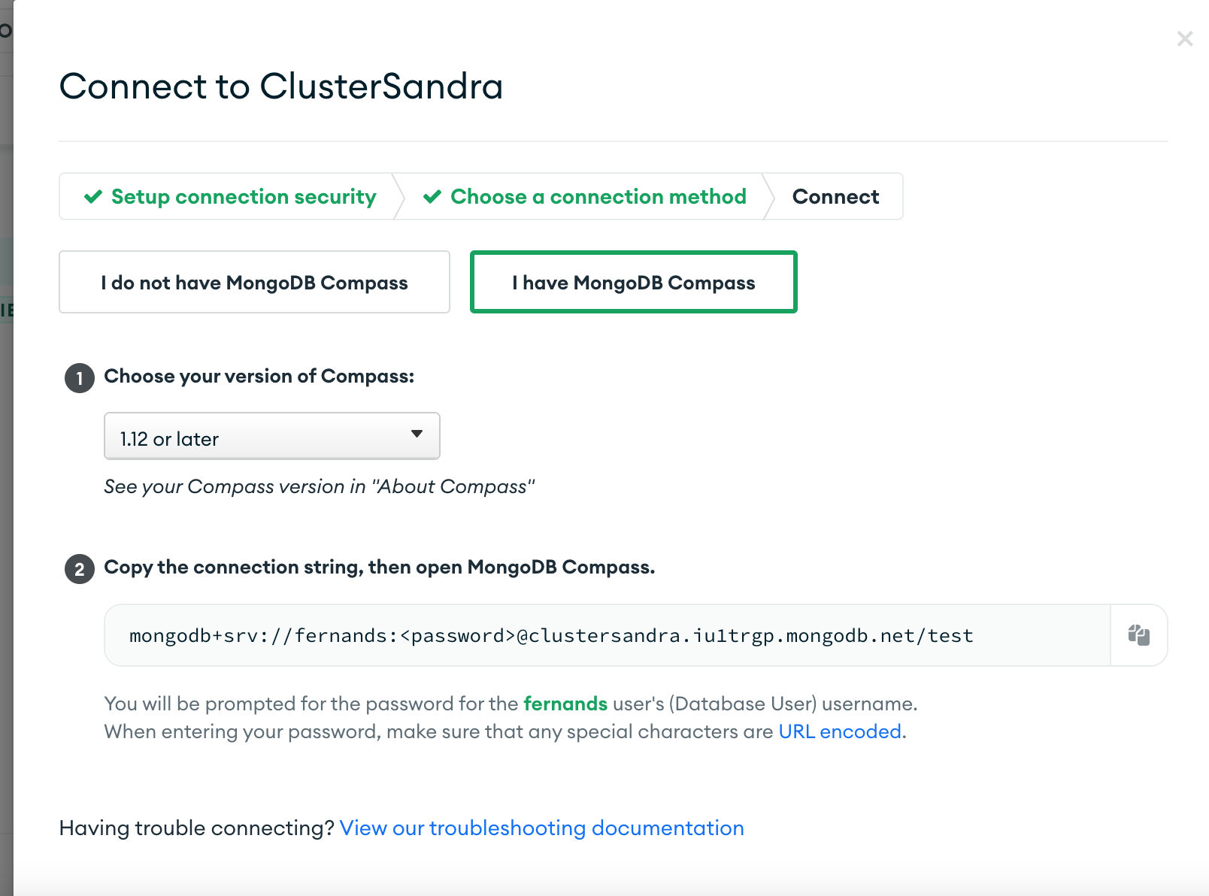
Connect to cluster and bring those sample databases
Database > Database Deployments > connection
Then build your connection to access from anywhere (follow screen instruction)
You will also have to create a user (follow screen instruction)
4. Copy the connection the cloud atlas generates and connect with your local MongoDB Compass

Slide 16
Create a New Database and Collection
To create a new database, issue the use <db> command with the database that you would like to create. For example, the following commands create both the database myNewDatabase and the collection mycollection.
Also Insert method input data to a new or an existing collection ‘unicorns’.
use myNewDatabase
db.createCollection("mycollection")
db.unicorns.insert({name: 'Aurora',
gender: 'f', weight: 450})
To terminate a running command or query: Ctrl + C

Slide 17
Perform CRUD Operations
Create or insert operations add new documents to a collection. If the collection does not exist, create operations also create the collection. You can insert a single document or multiple documents in a single operation.
use sample_mflix
db.movies.insertMany([
{
title: "Jurassic World: Fallen Kingdom",
genres: [ "Action", "Sci-Fi" ],
runtime: 130,
rated: "PG-13",
year: 2018,
directors: [ "J. A. Bayona" ],
cast: [ "Chris Pratt", "Bryce Dallas Howard", "Rafe Spall" ],
type: "movie"
},
{
title: "Tag",
genres: [ "Comedy", "Action" ],
runtime: 105,
rated: "R",
year: 2018,
directors: [ "Jeff Tomsic" ],
cast: [ "Annabelle Wallis", "Jeremy Renner", "Jon Hamm" ],
type: "movie"
}
])
use sample_mflix
db.movies.insertOne(
{
title: "The Favourite",
genres: [ "Drama", "History" ],
runtime: 121,
rated: "R",
year: 2018,
directors: [ "Yorgos Lanthimos" ],
cast: [ "Olivia Colman", "Emma Stone", "Rachel Weisz" ],
type: "movie"
}
)

Slide 18
Read operation
To return all movies from the sample_mflix.movies collection which are either rated PG or PG-13:
To return all documents from the sample_mflix.movies collection:
use sample_mflix
db.movies.find()
-----------------
use sample_mflix
db.movies.find( { "title": "Titanic" } )
use sample_mflix
db.movies.find( { rated: { $in: [ "PG", "PG-13" ] } } )
To return movies which were released in Mexico and have an IMDB rating of at least 7:
use sample_mflix
db.movies.find( { countries: "Mexico", "imdb.rating": { $gte: 7 } } )

Slide 19
Update Operation
The update operation:
Uses the $set operator to update the value of the plot field for the movie Tag.
Uses the $CurrentDate operator to update the value of the lastUpdated field to the current date
If lastUpdated field does not exist, $CurrentDate will create the field.
To update the first document in the sample_mflix.movies collection where title equals "Tag":
use sample_mflix
db.movies.updateOne( { title: "Blacksmith Scene" },
{
$set: {
plot2: "One month every year, five highly competitive friends"
}
})
Use the db.collection.updateMany() to update all documents that match a specified filter.

Slide 20
Delete Operation
To delete all documents from the sample_mflix.movies collection where the title equals "Titanic":
use sample_mflix
db.movies.deleteMany( { title: "Titanic" } )
To delete all documents from the sample_mflix.movies collection:
use sample_mflix
db.movies.deleteMany({})
use sample_mflix
To delete the first document from the
db.movies.deleteOne( { cast: "Brad Pitt" } )

Slide 21
No Joins
The first and most fundamental difference that you’ll need to get comfortable with is MongoDB’s lack of joins. There is no design rational as to why some type of join syntax isn’t supported in MongoDB, however joins are generally seen as non-scalable.
That is, once you start to split your data horizontally, you end up performing your joins on the client (the application server) anyway. Regardless of the reasons, the fact remains that data is relational, and MongoDB doesn’t support joins.
Without knowing anything else, to live in a join-less world, we have to do joins ourselves within our application’s code. Essentially we need to issue a second query to find the relevant data in a second collection. Setting our data up isn’t any different than declaring a foreign key in a relational database.
Arrays and Embedded Documents
Just because MongoDB doesn’t have joins doesn’t mean it doesn’t have a few tricks up its sleeve. Remember when we saw that MongoDB supports arrays as first class objects of a document? It turns out that this is incredibly handy when dealing with many-to-one or many-to-many relationships.

Slide 22
Denormalization
Yet another alternative to using joins is to denormalize your data. Historically, denormalization was reserved for
performance-sensitive code, or when data should be snapshotted (like in an audit log).
However, with the ever growing popularity of NoSQL, many of which don’t have joins, denormalization as part of normal modelling is becoming increasingly common.
This doesn’t mean you should duplicate every piece of information in every document. However, rather than letting fear of duplicate data drive your design decisions, consider modelling your data based on what information belongs to what document.
For example, say you are writing a forum application. The traditional way to associate a specific user with a post is
via a userid column within posts. With such a model, you can’t display posts without retrieving (joining to) users.
A possible alternative is simply to store the name as well as the userid with each post. You could even do so with an
embedded document, like user: {id: ObjectId('Something'), name: 'Leto'}. Yes, if you let users change their
name, you may have to update each document (which is one multi-update).
Adjusting to this kind of approach won’t come easy to some. In a lot of cases it won’t even make sense to do this.
Don’t be afraid to experiment with this approach though. It’s not only suitable in some circumstances, but it can also
be the best way to do it.

Slide 23
Run Aggregation Pipelines
You can run aggregation pipeline on your collections using the MongoDB Shell. Aggregation pipelines transform your documents into aggregated results based on selected pipeline stages. Common uses for aggregation include:
Grouping data by a given expression.
Calculating results based on multiple fields and storing those results in a new field.
Filtering data to return a subset that matches a given criteria.
Sorting data.
When you run an aggregation, MongoDB Shell outputs the results directly to the terminal.
db.<collection>.aggregate([
{
<$stage1>
},
{
<$stage2>
}
...
])

Slide 24
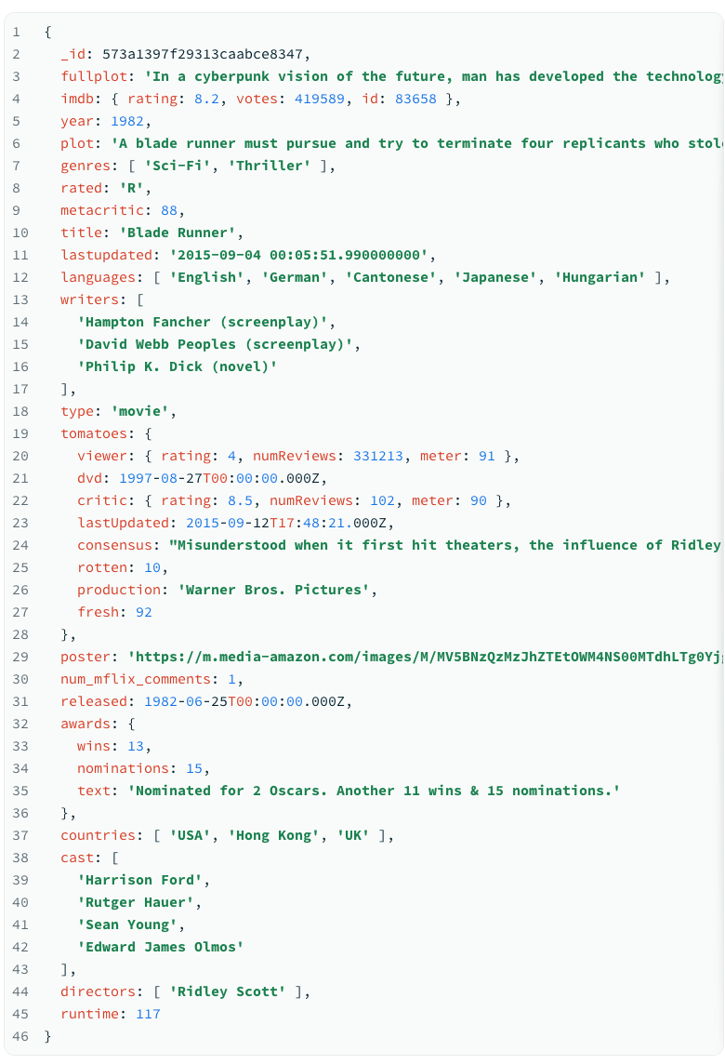
Example
Each document in the movies collection describes a movie:
db.movies.aggregate([
// First Stage
{ $project: { _id: 0, genres: 1, imdb: 1, title: 1 } },
// Second Stage
{ $unwind: "$genres" },
// Third Stage
{ $group:
{ _id: "$genres", averageGenreRating: { $avg: "$imdb.rating" }
}
},
// Fourth Stage
{ $sort: { averageGenreRating: -1 } }
] )
https://www.mongodb.com/docs/mongodb-shell/run-agg-pipelines/

Slide 25
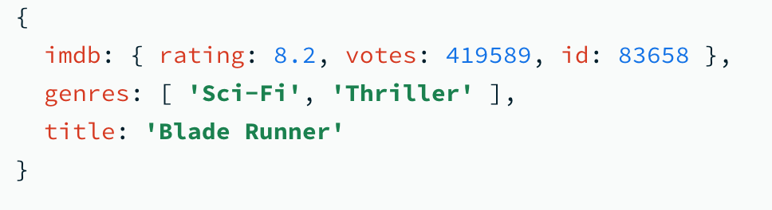
First Stage
The $project stage passes documents that contain the following fields to the next pipeline stage:
genres
imdb
Title
Documents from the collection that don't include all of these fields are not passed to the next pipeline stage.

Slide 26
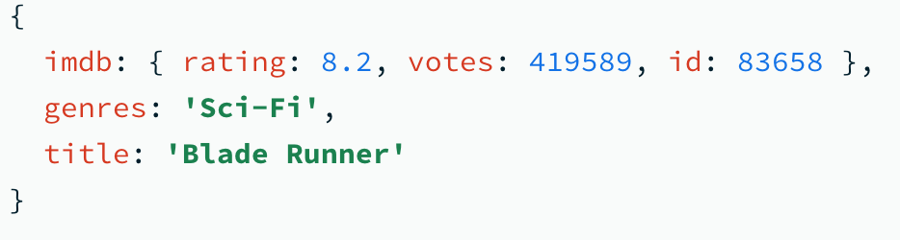
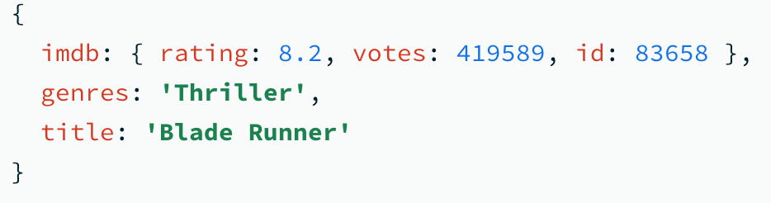
Second Stage
The $unwind stage passes a document for each element in the genres array to the next pipeline stage.
The $unwind stage generates the following two documents from the original example document, then passes them to the next pipeline stage:

Slide 27
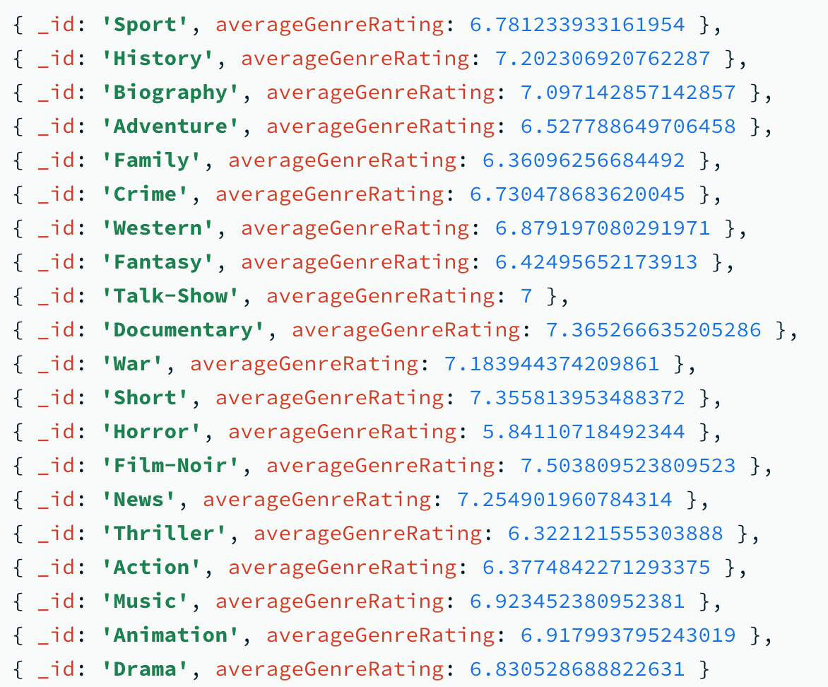
Third stage
The $group stage:
Retrieves the distinct genre values from the documents it receives from the previous pipeline stage,
Creates a document for each distinct genre where the _id is the genre name,
Adds a field, averageGenreRating, to each new document that contains the average imdb.rating of all documents that match the genre, and
Passes the new documents to the next pipeline stage.
This stage sends documents that look similar to the following to the next pipeline stage:

Slide 28
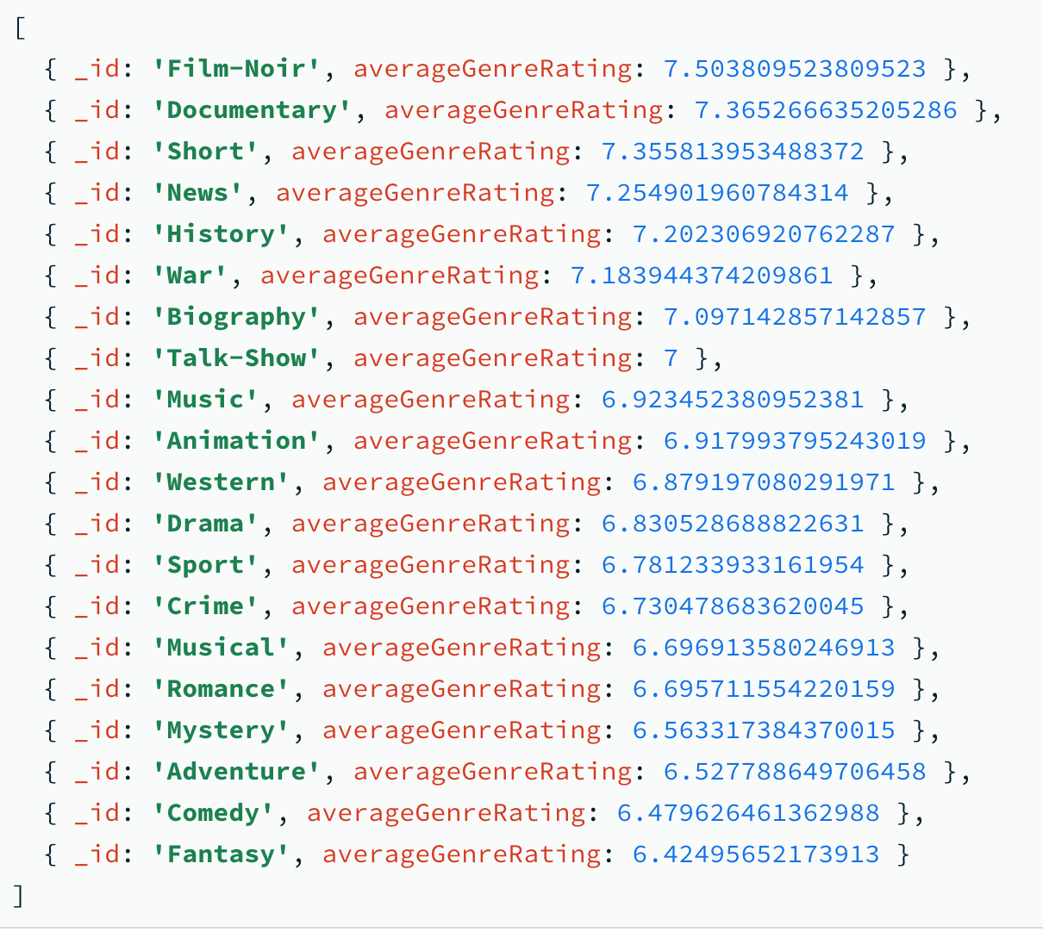
Forth Stage
The $sort stage sorts the documents it receives from the previous stage in descending order based on the value of the averageGenreRating field.
When you run the example pipeline the MongoDB Shell prints documents similar to the following to the terminal:

Slide 29
MongoDB Tools
Indexes
‘getIndexes’ command which shows information on all the indexes in a collection. Indexes in MongoDB work a lot like indexes in a relational database: they help improve query and sorting performance.Indexes are created via ensureIndex:
Explain
To see whether or not your queries are using an index, you can use the explain method on a cursor:
Replication
MongoDB replication works in some ways similarly to how relational database replication works. All production deployments should be replica sets, which consist of ideally three or more servers that hold the same data. Writes are sent to a single server, the primary, from where it’s asynchronously replicated to every secondary. You can control whether you allow reads to happen on secondaries or not, which can help direct some special queries away from the primary, at the risk of reading slightly stale data. If the primary goes down, one of the secondaries will be automatically elected
to be the new primary.

Slide 30
Sharding
MongoDB supports auto-sharding. Sharding is an approach to scalability which partitions your data across multiple servers or clusters. A naive implementation might put all of the data for users with a name that starts with A-M on server 1 and the rest on server 2.
Thankfully, MongoDB’s sharding capabilities far exceed such a simple algorithm.
Sharding is a topic well beyond the scope of this lecture, but you should know that it exists and that you should consider it, should your needs grow beyond a single replica set.

Slide 31
Reference
https://www.mongodb.com/docs/mongodb-shell/
https://www.youtube.com/watch?v=ExcRbA7fy_A
https://www.openmymind.net/mongodb.pdf
Sandra Fernando

Slide 32
Thank you for Listening…

